Slide 1
The People of the Plains
By: Chelsea & Elsa

Slide 2
Map
Topography
The plains are not entirely flat, there are gently rolling hills and river valleys.
Vegetation
The plains include wonderful deciduous trees, grassland, boreal forest,and it's gradually becoming a tundra.
Climate
The climate of the plains is a continental climate, it included colder and longer winters, and long and hot summers.

Slide 3
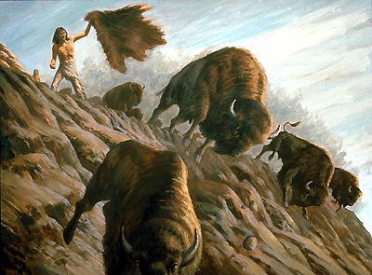
Subsistence
What type of food did they eat?
The people of the plains had a very limited amount of food to choose from.Their main source of nutrition was from bison meat (buffalo meat). Plains people also ate pemmican cake,deer and moose meat.
How did they obtain their food?
Requiring food took a lot of effort because they had to hunt for their food. Plains people hunted for bison using the "bison jump" method. Which is leading the buffalo over the edge of the cliff, resulting in death.

Slide 4
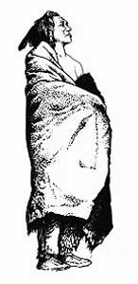
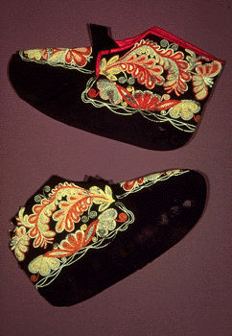
Clothing
What type of clothing did they wear?
The plains people had many types of clothing to choose from. They chose to wear tunics, leggings, skirts, breechclothes, and moccasins.
What materials did they use to make the clothing?
The clothing was often made by deer skin, moose hide, or specifically buffalo hide.

Slide 5
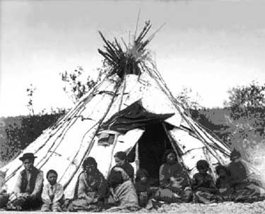
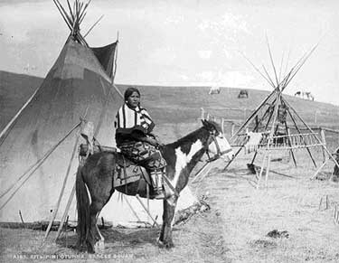
Shelter
What type of shelter did they build or reside?
The plains people had built tipis to live in. A tipi is a tall, cone-like structure; the Tipi was waterproof and could deal with the weather.
What materials did they use for their shelter?
A tipi was made of pine poles and animal hides.

Slide 6
Religion
The people of the plains had only one belief and that was The Great Spirit. The Great Spirit was powerful to them. It had power over all things like animals and trees. They believed that the Earth was mother of all spirits. They believed that the Sun also gave great power, giving the Earth light and warmth. The people of the plains say that spirits caused visions in dreams.

Slide 7
It was a belief that many things such as plants and clouds were possessed spirits. The Earth was the mother of all spirits and each spirit could be prayed to. Shamans were blessed people who had received a sign from the Great Spirit to become healers. And in the warmer months, ceremonies were held as the nomadic groups united.

Slide 8
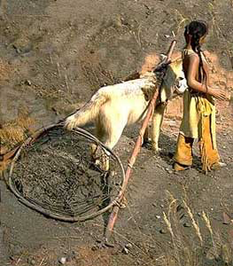
Transportation
The people of the plains didn't have many choices when it came to transportation. They usually rode horses. When winter came around, they used sleds that were pulled by dogs. The plains often travel by foot so in the winter, they also used snowshoes to help with the deep snow.

Slide 9
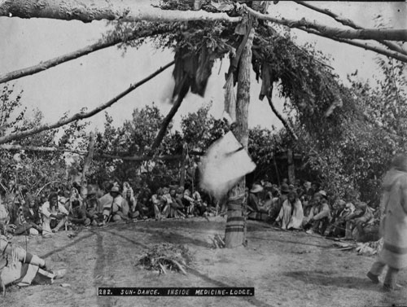
Social OrganizatioN and Government
The chief held the most respect. As long as the chief was successful or bringing home food, they supported the chief. In the midsummer time, when the buffaloes were in larger herds, the group would hunt for them. If they were successful, the bands would come together and for a few weeks becoming one large tribal encampment.

Slide 10
Citations
"Baby Bison – A Cute A Day." A Cute A Day. Web. 06 June 2016.
Cranny, Michael William. Crossroads: A Meeting of Nations. Scarborough, Ont.: Prentice Hall Ginn Canada, 1998. Print.
Plains First Nations - Spiritual Beliefs, Traditions, Dances, Ceremonies." Plains First Nations - Spiritual Beliefs, Traditions, Dances, Ceremonies. Web. 06 June 2016.
"Aboriginal People: Plains." The Canadian Encyclopedia. Web. 06 June 2016.
"Moccasin." The Canadian Encyclopedia. Web. 06 June 2016.
"The Plains People - Environment / Housing." The Plains People - Environment / Housing. Web. 06 June 2016.
"The Plains People - Groups in This Region." The Plains People - Groups in This Region. Web. 06 June 2016.
"Plains People - Religion / Ceremonies / Art / Clothing." The Plains People - Religion / Ceremonies / Art / Clothing. Web. 06 June 2016.
"The Plains People - Transportation / Migration." The Plains People - Transportation / Migration. Web. 06 June 2016.

